Slide 1
Movie Ticket Booking System
Group Members :
Yogesh Satish Badgujar - 3805
Krish Gulab Patil - 3976
Vishal Prabhakar Patil - 3997

Slide 2
AIM OF THE PROJECT
Online Movie Ticket Booking System is a web app to provide the users’ facility to book tickets for a show and to collect information regarding the films and theaters.
Client has to register at the positioning to book tickets to the show. When choosing the show, the user is given a seating layout in order that he will choose seats of his selection.
Thenceforth he's redirected to the payment entryway for creating a group action. User will update his profile, take a print out of the price tag and conjointly read his booking history.
The most aim of the project is any user they can access the system through web site at any time while not planning to the corporate.
As a replacement user conjointly he will collect all info like as movies out there, list of theatres.

Slide 3
OBJECTIVE OF THIS PROJECT
The main purpose of our online ticket booking system is to provide another way for the customer to buy cinema ticket. It is an automatic system.
After inserting the data to database, staff need not to due with the order receive through the system. In fact, there is similar system on the internet, but there is no refund method found in the existing system.
This system is basically aimed to provide the customer the complete information of the movie, according to which the customer can book the tickets and the refund facility provides more flexibility to the system.
The goals of our system are:
To provide a anytime anyplace service for the customer
To minimize the number of staff at the ticket box
To promote the film on the internet
To increase the profit
To obtain statistic information from the booking record

Slide 4
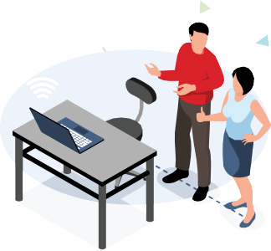
SOFTWARE AND HARDWARE REQUIREMENTS
HARDWARE REQUIREMENTS :
Processor : Intel 5
Motherboard : Intel mother board – VTx Enabled
Ram : 8 gb
Hard disk drive : 500 gb
SOFTWARE REQUIREMENTS :
Front end : html5, css3, JavaScript, React.js
Back end : Node.js, Express.js, Mongoose
Databse : MongoDB
TOOLS :
Visual Studio Code
NPM Libraries
Font Owsome Properties
Sweet Alert Libraries
React + Vite

Slide 5
PURPOSE SYSTEM
The main purpose of the online ticket booking and purchasing system is to provide a convenient way of customers to buy cinema tickets.
It is a real time system and though there are similar systems for more advanced countries, they do not provide an alternate online payment means such as the use of webs money from other telecommunication networks other than credit cards.
Also been able to watch a preview of the movie you want to purchase tickets for such as trailers and other shot scenes, and also receiving an SMS notification for the approval of your purchase.

Slide 6
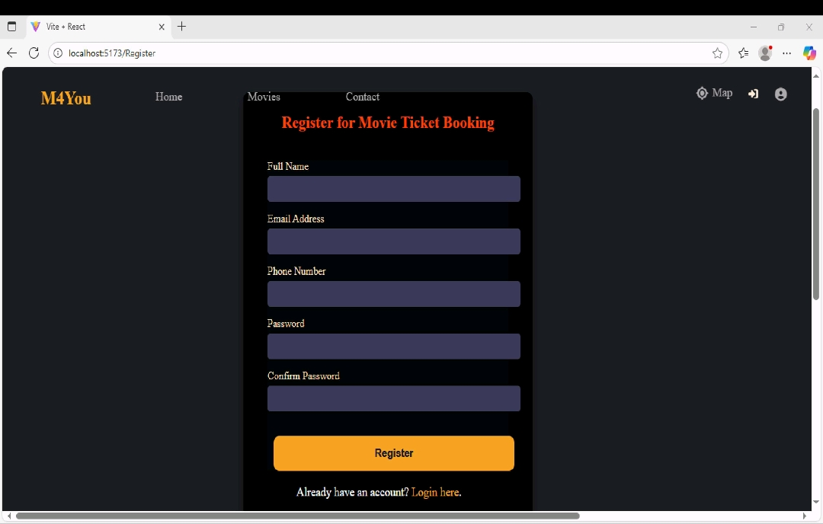
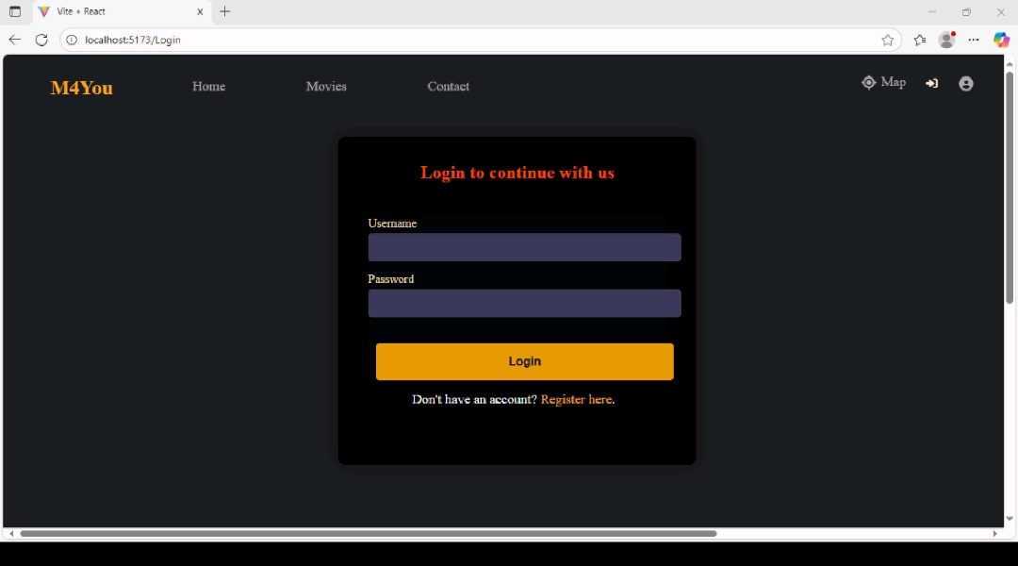
Registration
Login

Slide 7
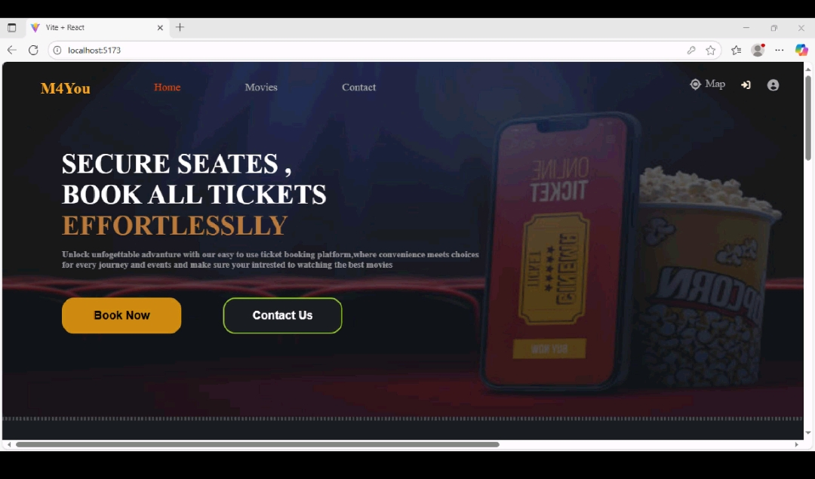
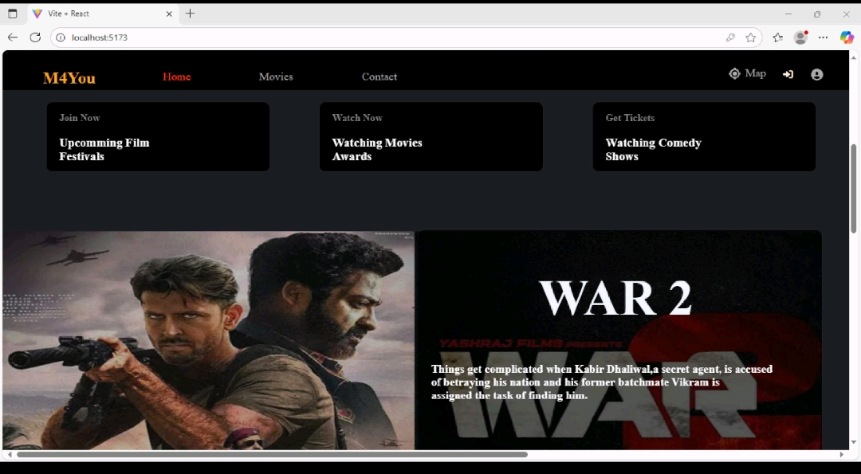
Home Page
Home Components

Slide 8
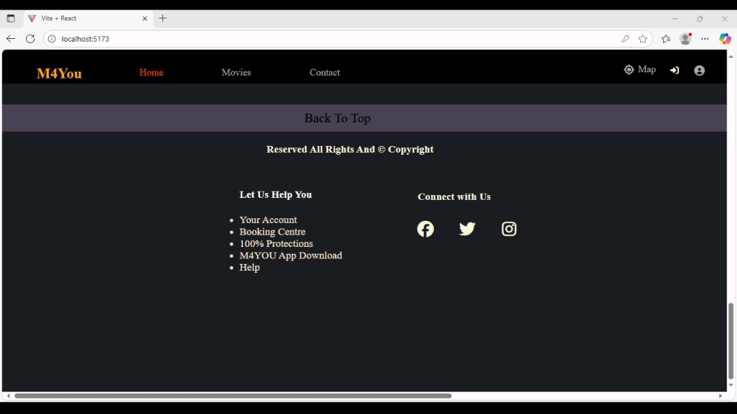
Navbar And Footer

Slide 9
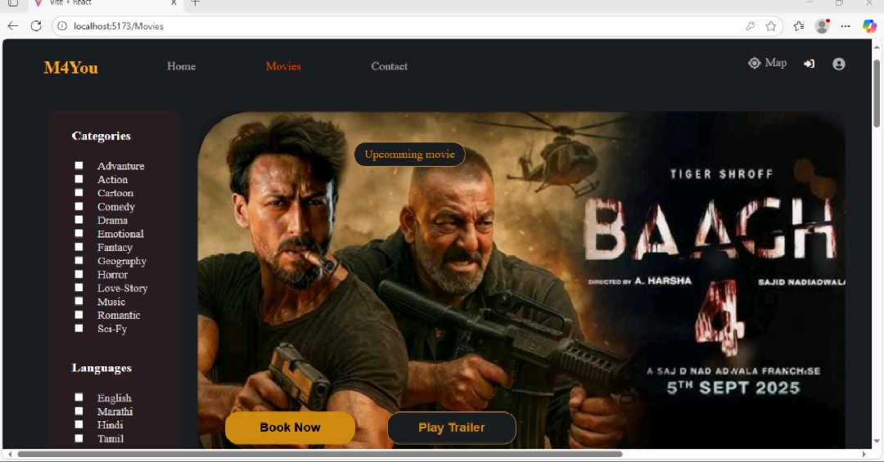
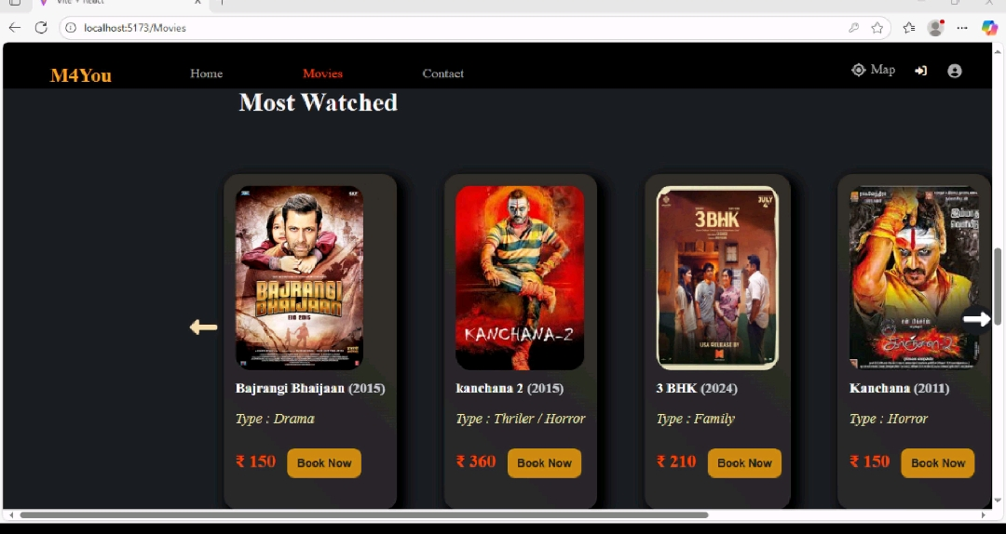
Movie Listing Page

Slide 10
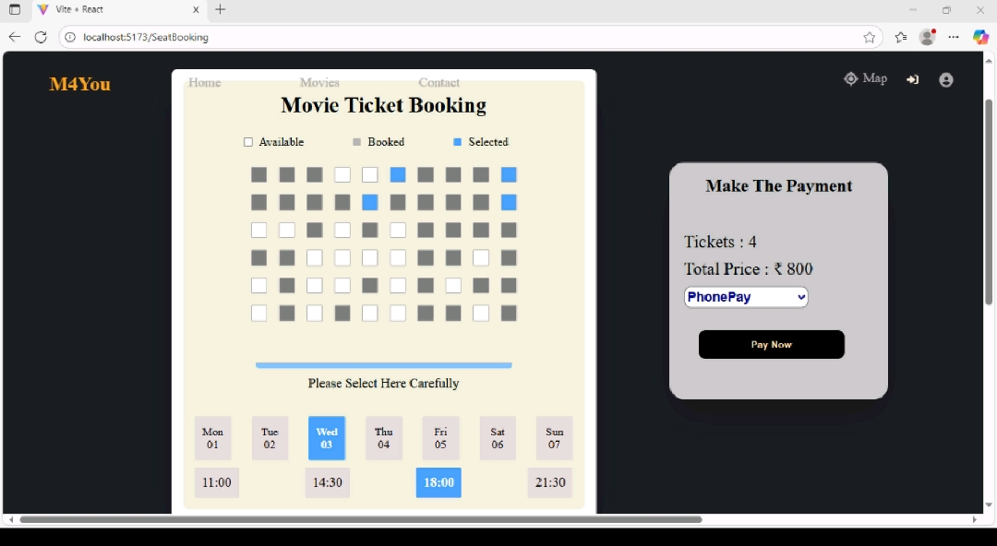
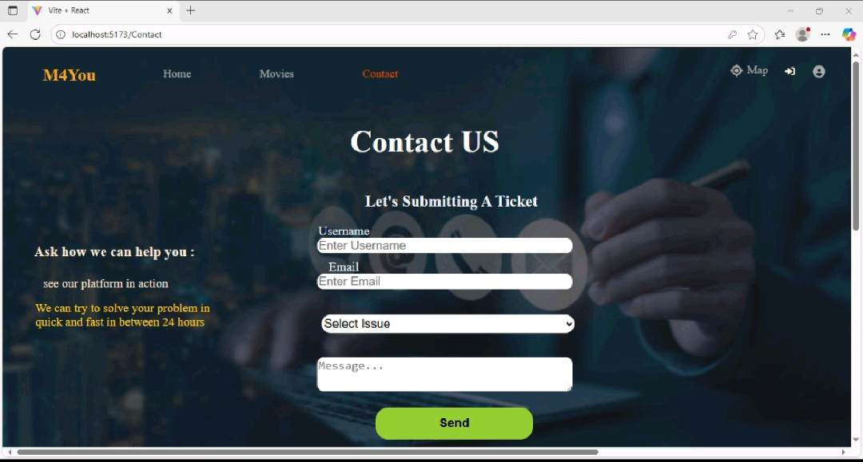
SeatBooking Page
Contact US Page

Slide 11
MODULE LIST
ADMIN
Register
Login
View Users Details
Update Users Details
Delete Users Details
View Bookings
View Feedback

Slide 12
MODULE LIST
USER
Register
Login
Payment System
View Movies Listing
Book Movies
After Booking Showing Notification
Feedback

Slide 13
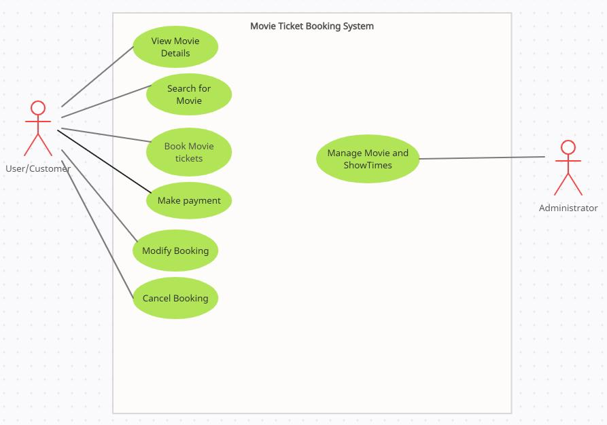
DIAGRAMS
ARCHITECTURE DIAGRAMS

Slide 14
USECASE DIAGRAMS
USER

Slide 15
ADMIN

Slide 16
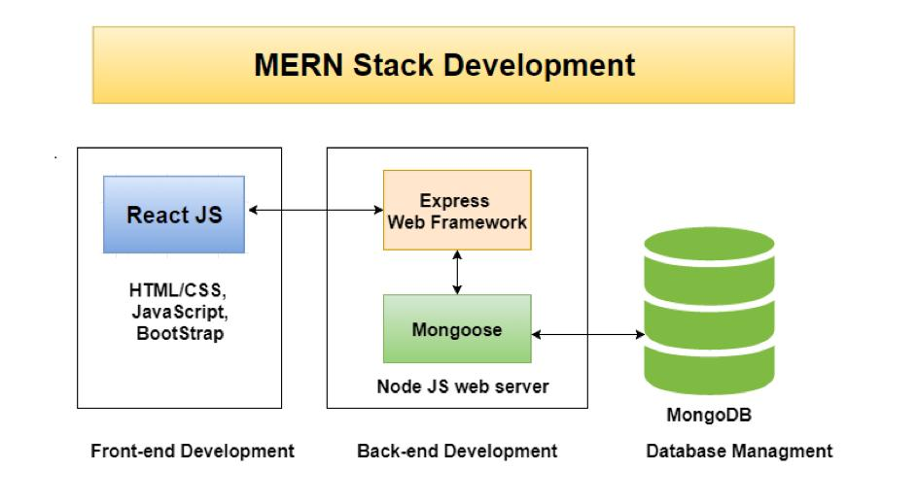
WORKFLOW DIAGRAM FOR WEB APPLICATION

Slide 17
CONCLUSION
The entire project has been developed and deployed as per the requirements stated by the user, it is found to be bug free as per the testing standards that is implemented.
Any specification-untraced errors will be concentrated in the coming versions, which are planned to be developed in the future.
The system at present does not take care of the money payment methods, as the consolidated constructs need SSL standards.

Slide 18
FUTURE ENHANCEMENT
In Future work, This application to develop a cross platforms like IOS, Android etc.
In adding the more features Online Movie ticket booking application to develop access with user’s flexibility.
To authenticate the users based on the system users list which is maintained by the operating system
To restrict the usage of all files by the users based on their privileges on the system
Implemented Map System in UI.
States & City Wise Seat Booking.
Seat Classes like (Royal, Royal Reclainer, Club)

Slide 19
REFERNECES
Budd, T. (1997b), An Introduction to Object-Oriented Programming,2nd edn, Addison-Wesley.
Ghezzi, C., Jayazeri, M. & Mandrioli, D. (1998), Fundamentals of Software Engineering, 2nd edn,Prentice-Hall.
K. Appel and W. Haken. (1976), Every Planar Map is 4-colorable, Bull. Amer. Math. Soc., vol. 82, pp. 711-712.
Hillenbrand, M 2001, Produce Your Play Without a Producer, Smith ans Kraus, Inc, Hanover, NH, USA.
Schneider, Re & Ford, MJ 1993, The Well-Run Theatre, Drama Book Publishers, New York
Pick, J 1985, The Theatre Industry, Comedian Publishing Group, UK.

Slide 20
THANK YOU

